Slide 1
Goon Cocoon And The Quest For The Gig Of Truth
Programmed by Diego Kopado
Story by Noah English and Diego Kopado

Slide 2
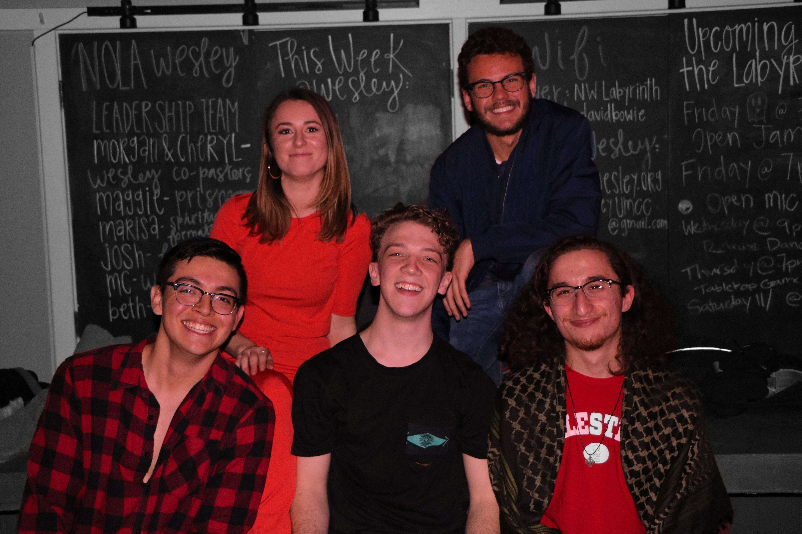
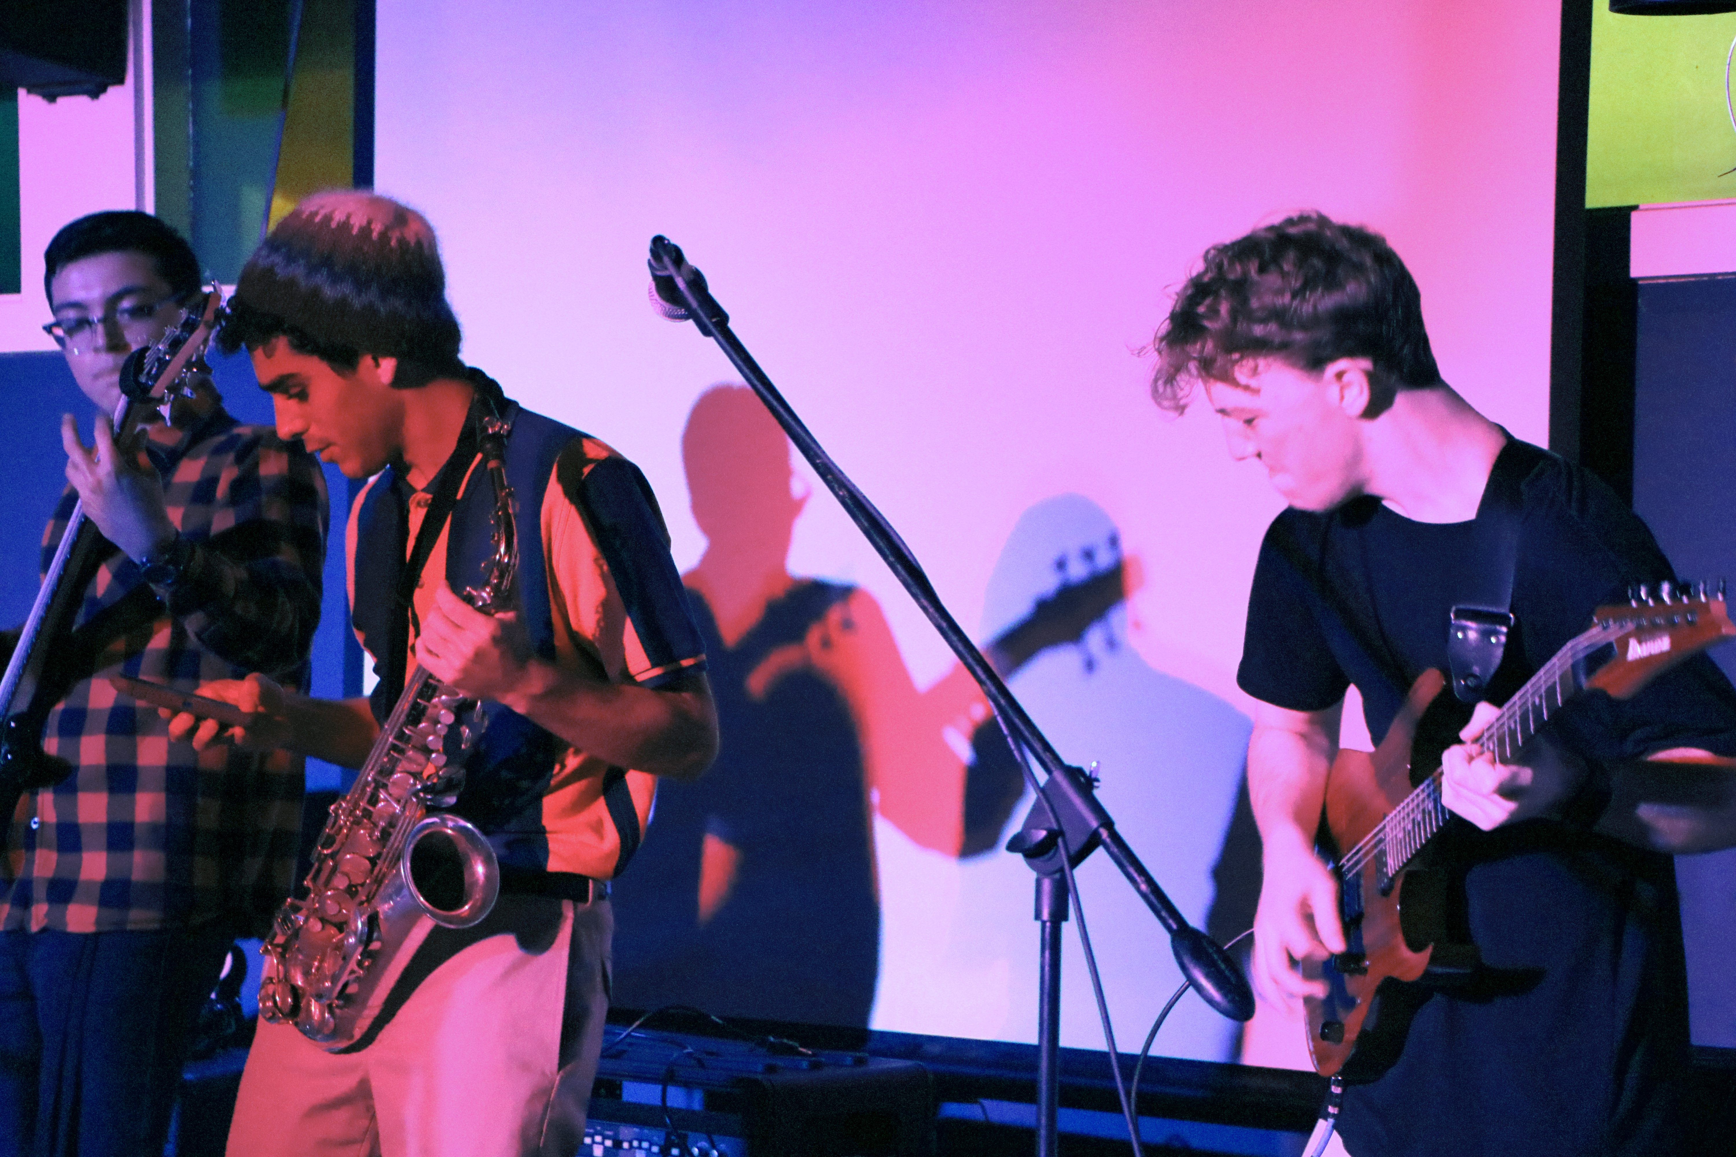
What is A goon cocoon?

Slide 3
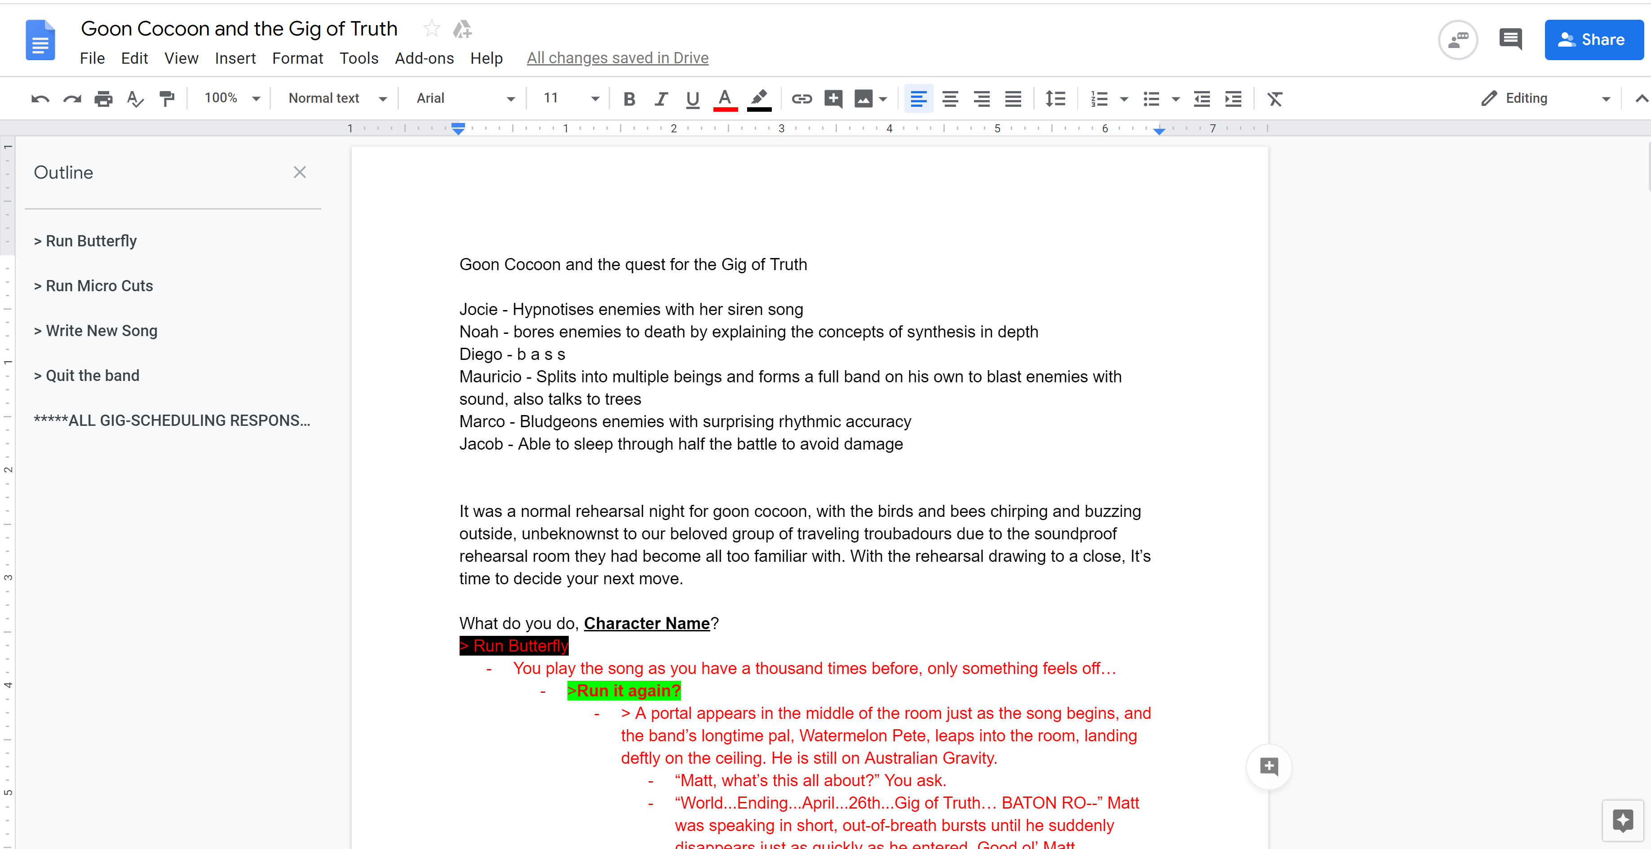
Goon Cocoon And The Quest For The Gig Of Truth

Slide 4
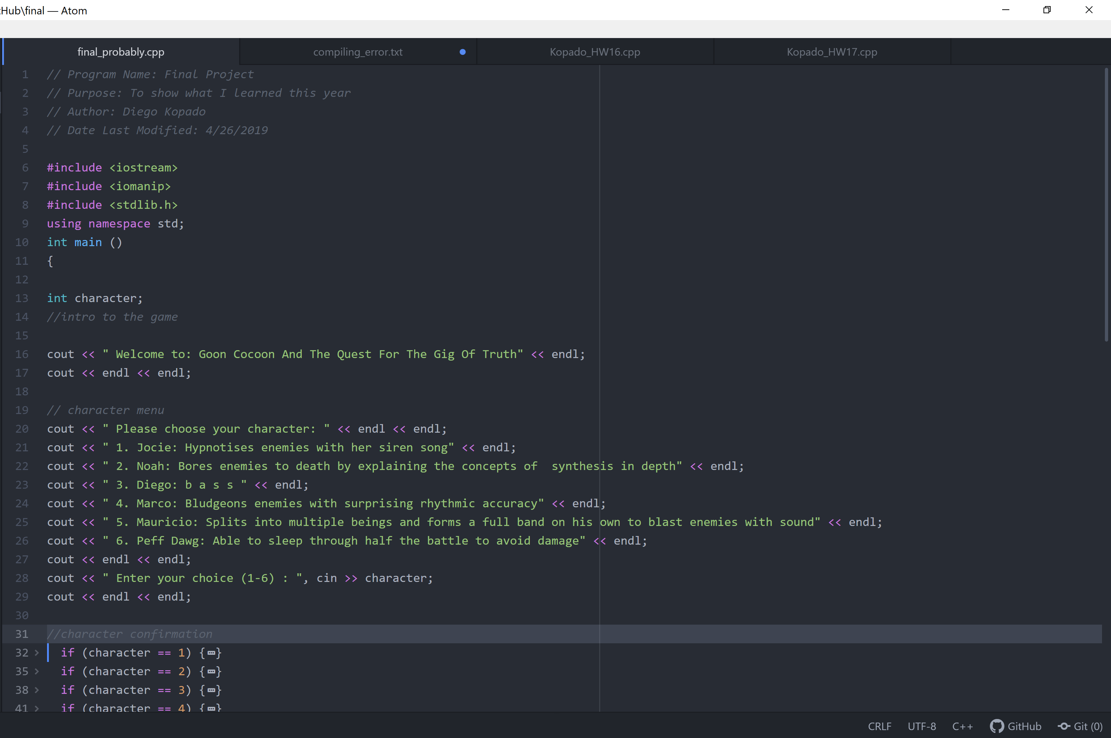
Goon Cocoon And The Quest For The Gig Of Truth

Slide 5
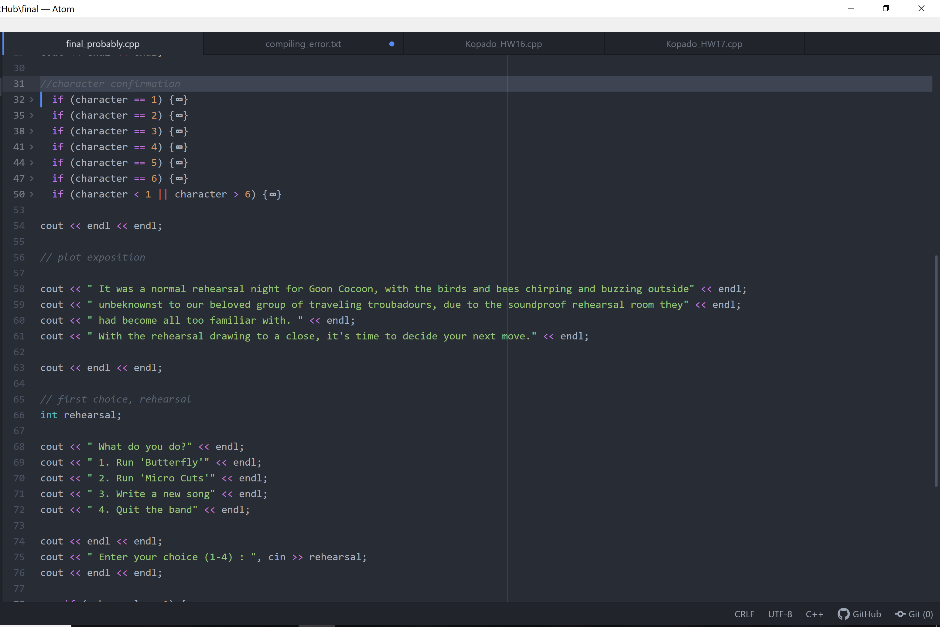
Goon Cocoon And The Quest For The Gig Of Truth

Slide 6
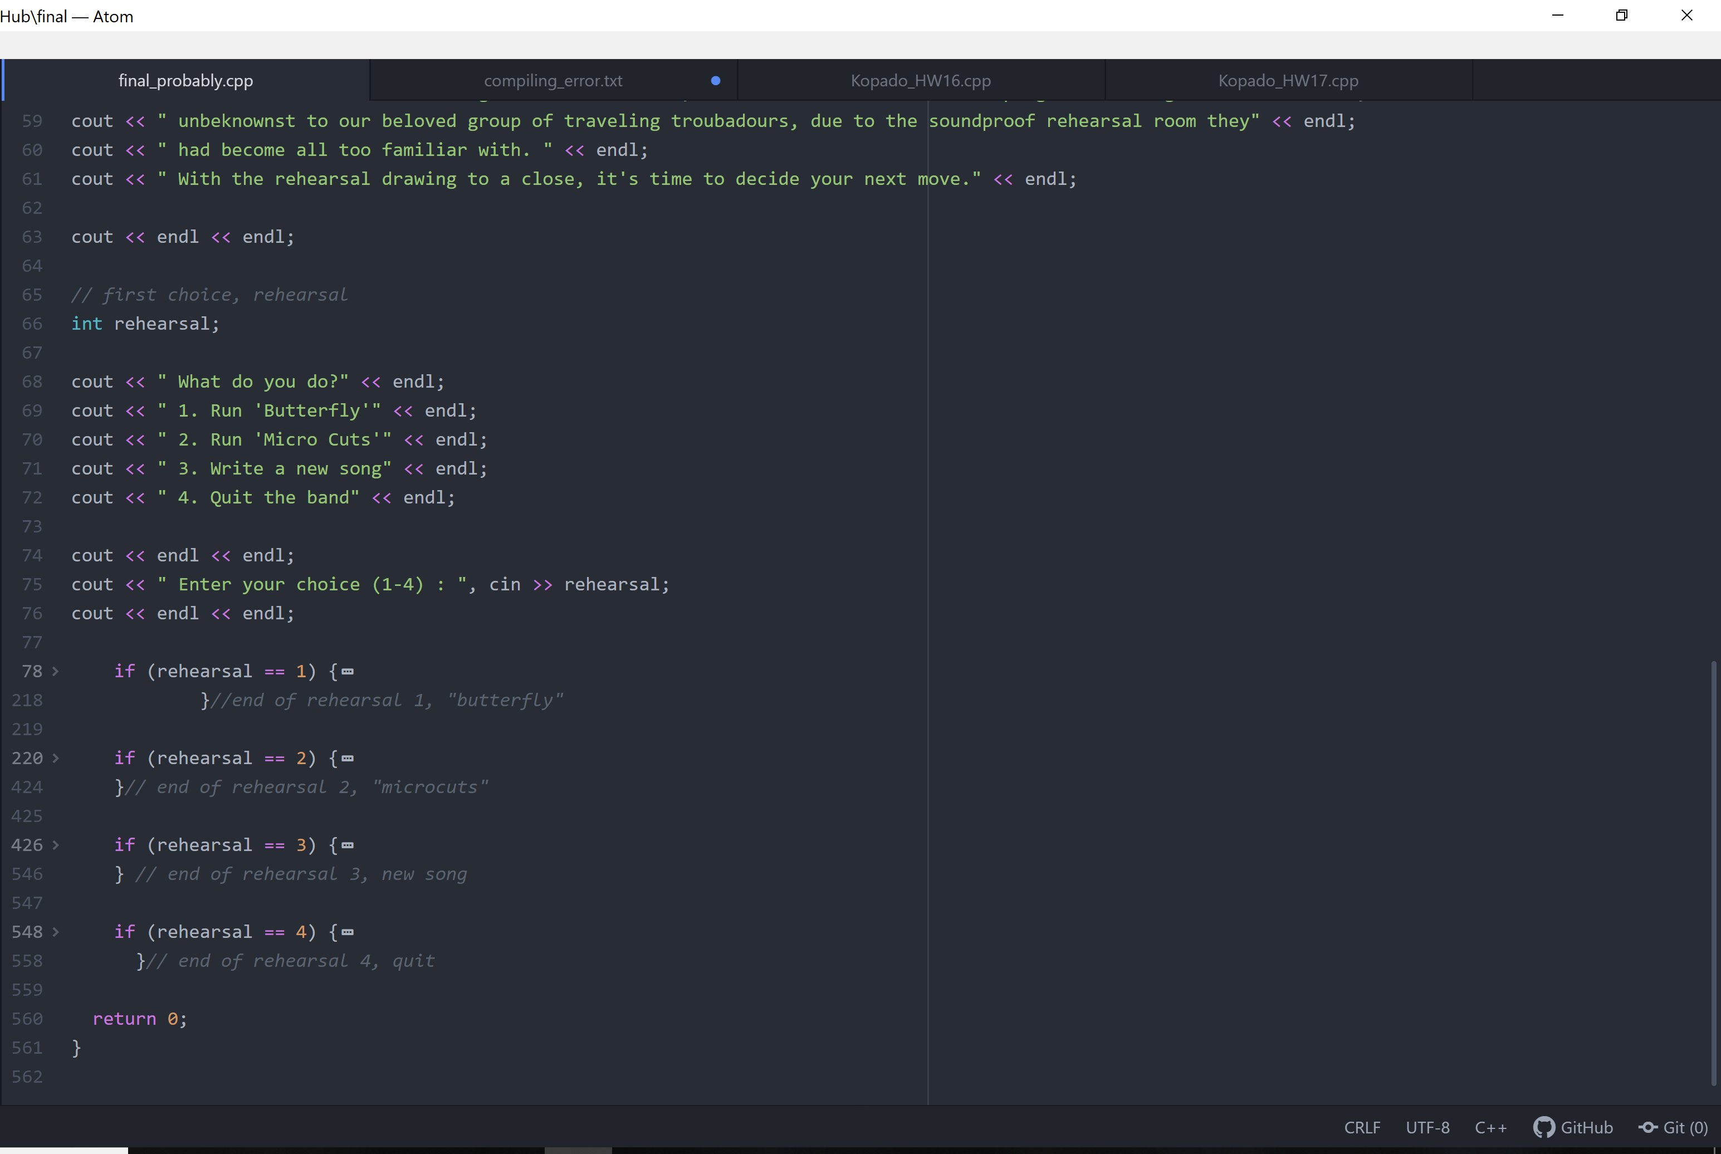
Goon Cocoon And The Quest For The Gig Of Truth

Slide 7
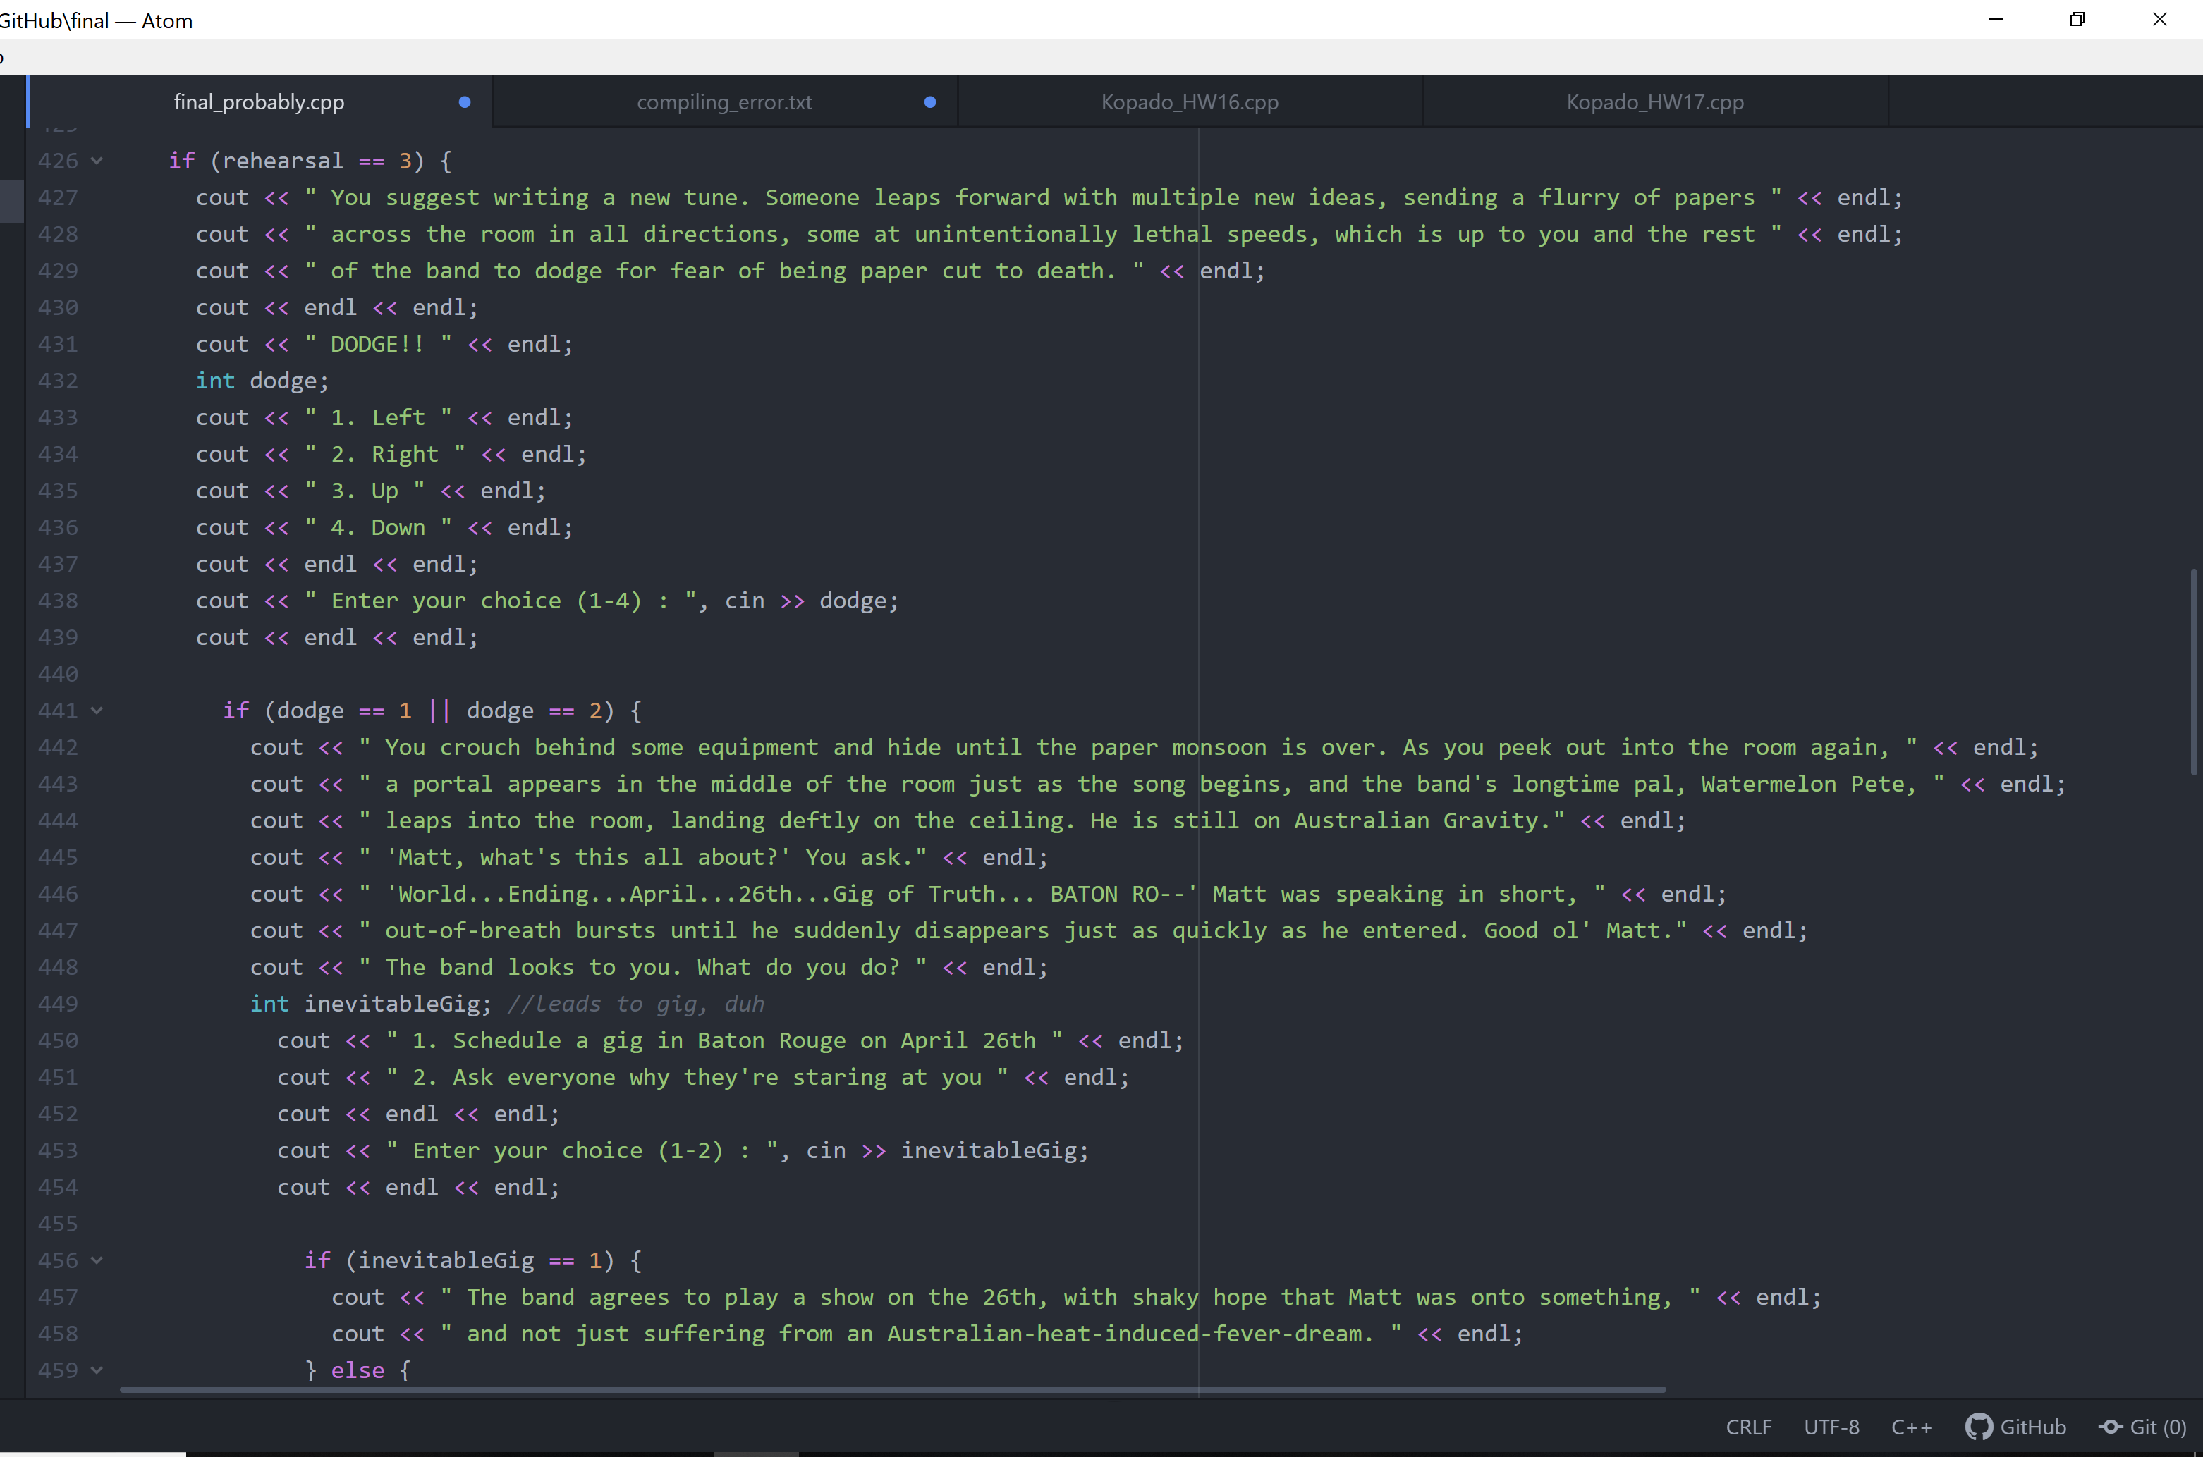
Goon Cocoon And The Quest For The Gig Of Truth

Slide 8
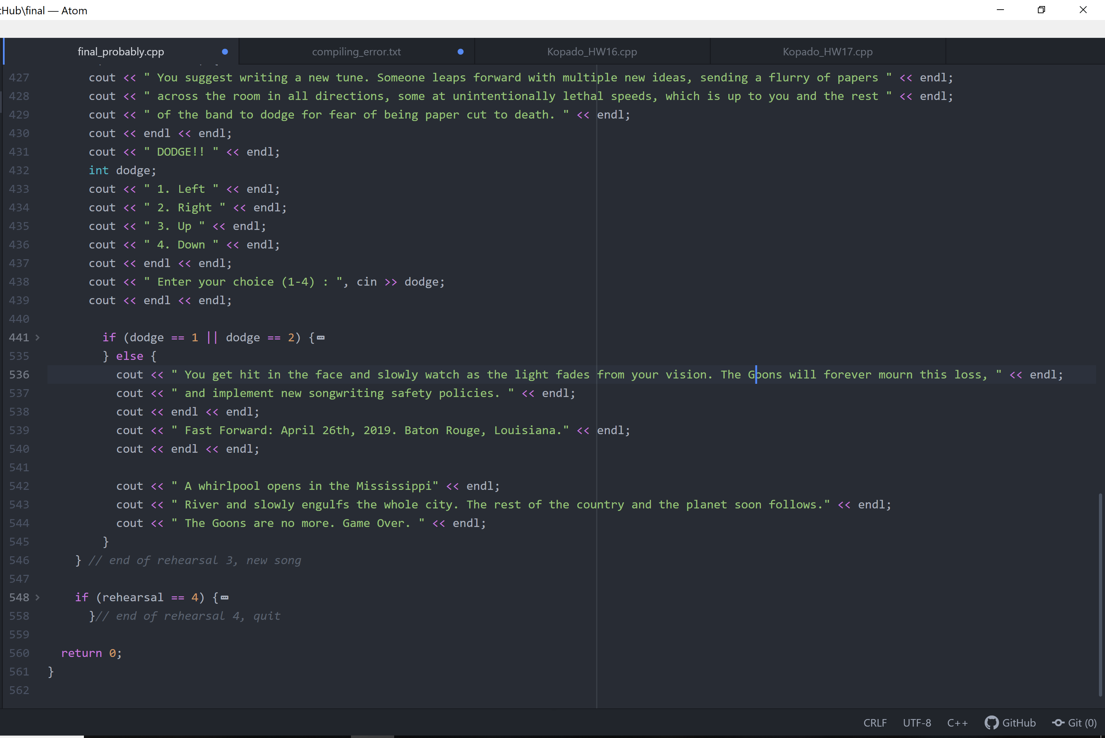
Goon Cocoon And The Quest For The Gig Of Truth

Slide 9
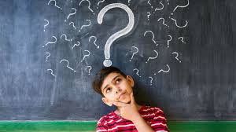
Lessons learned
0-100
Critical Thinking
Practice
Looking Forward

